Slide 1
Mechanical digestion
AEHBY ATAR Human Biology

Slide 2
Review
Explain the difference between bolus, chyme and faeces.
Describe three types of muscle tissue.
Would digestion be an example of anabolism or catabolism? Explain.
What is enzyme denaturation?
Which type of blood vessels would be most abundant in the villi of the small intestine? What other vessels are here?

Slide 3
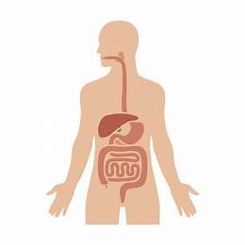
Learning Intentions
Digestion involves the breakdown of large molecules to smaller ones by mechanical digestion (teeth, peristalsis, churning and bile).

Slide 4
Success Criteria
Define mechanical digestion.
Describe peristalsis, identify how, where and why it occurs.
Compare mechanical digestion by teeth, peristalsis, churning and bile (droplet formation)

Slide 5
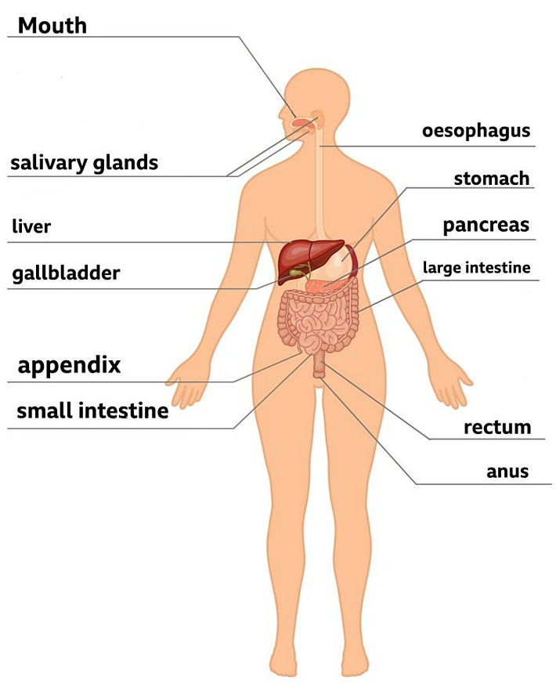
Digestive processes
There are four processes that happen in the digestive system:
ingestion (eating) →
digestion (breaking down) →
absorption →
egestion (removal from the body)

Slide 6
Ingestion
Food enters the digestive system through the mouth.
The food is chewed to form a ball of food called a bolus.
Both mechanical (chewing) and chemical (enzyme activity) occur in the mouth, as well as moistening food with saliva.
Chewing increases surface area.

Slide 7
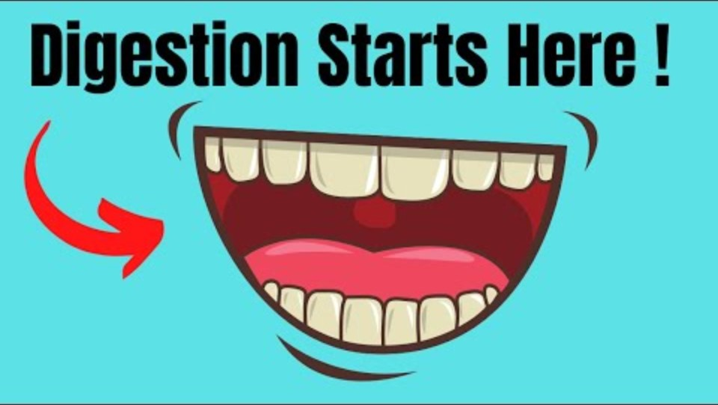

Slide 8
Digestion
the breaking down of the food into other substances that our bodies can absorb and use
can be mechanical or chemical

Slide 9
Mechanical digestion:
chewing with teeth.
peristalsis in the oesphagus.
churning in the stomach.

Slide 10
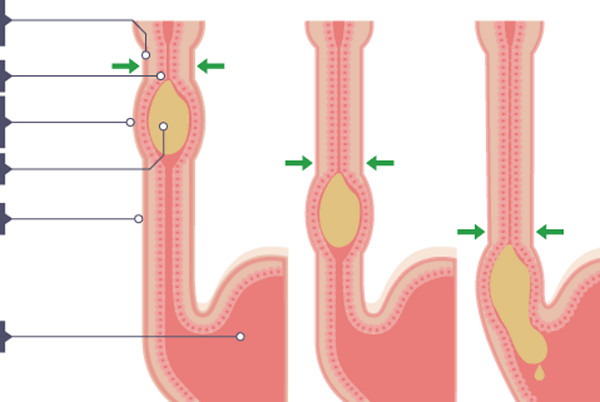
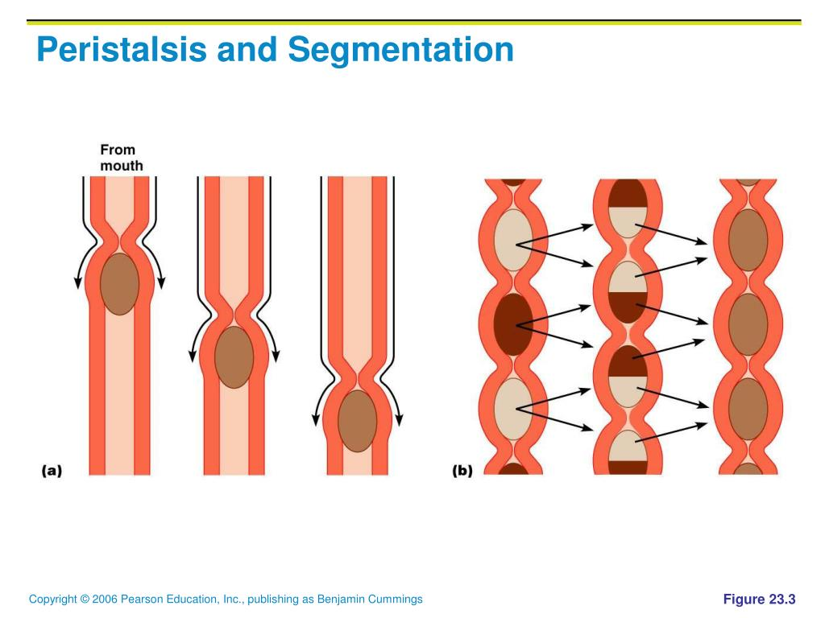
Peristalsis
two sets of muscles work together to produce wave-like movements
moves and mixes bolus

Slide 11
Churning
Layers of muscle in the stomach walls continually move and mix the bolus with enzymes and acid.

Slide 12
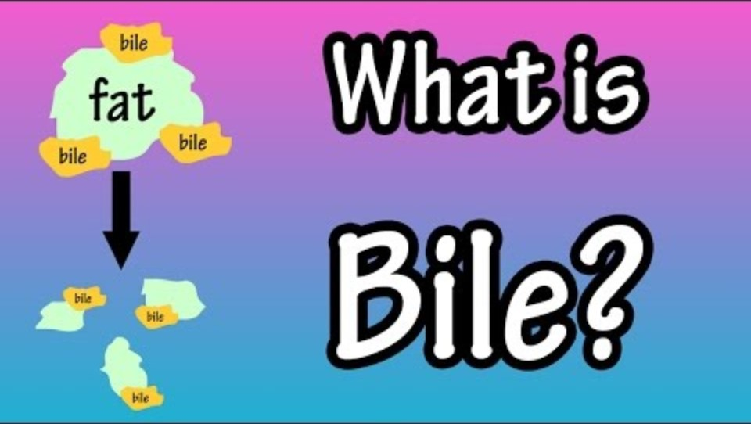

Slide 13
Questions
Define mechanical digestion.
Give four examples of mechanical digestion.
Why does bile action count as mechanical rather than chemical?
What is the purpose of mechanical digestion?

Slide 14
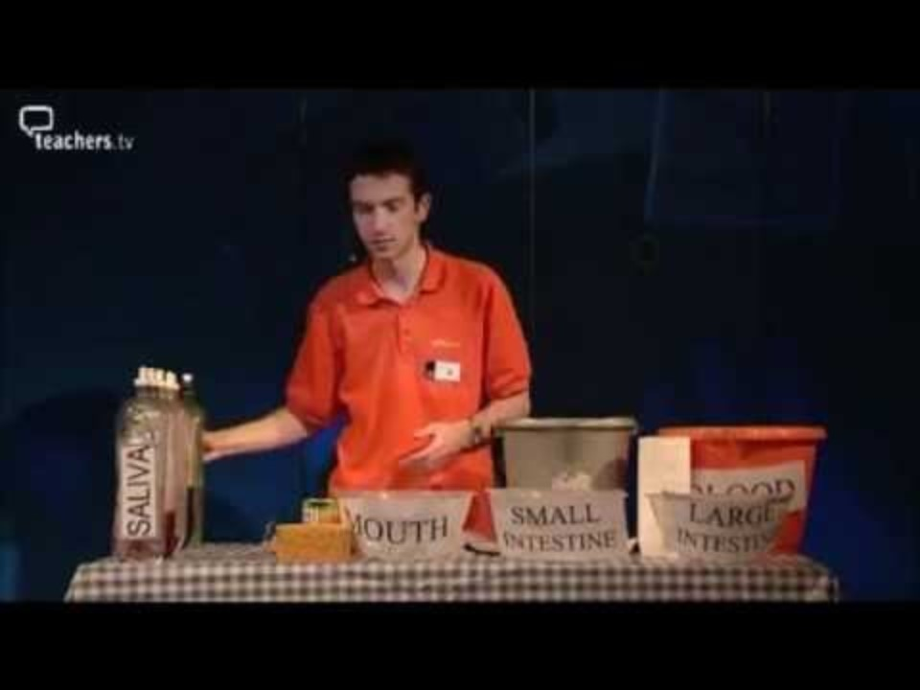

Slide 15
Success Criteria
Define mechanical digestion.
Describe peristalsis, identify how, where and why it occurs.
Compare mechanical digestion by teeth, peristalsis, churning and bile (droplet formation)

